Slide 1
Project Name
EMPLOYEE BIODATA MANAGEMENT SYSTEM

Slide 2
Team Details
TEAM NAME:THE B TEAM
TEAM LEADER:V.VINCLIN JENU
TEAM MEMBERS:
BARATH ANAND
SHERLY MARY G
KEERTHIKA K
KAVIYA PRIYANKA
Notes:
-Add team details with name and qualification,e-mail,phone no and place

Slide 3
DATABASE Design
SQL
USER DETAILS
PERSONAL DETAILS
BIODATA
BASIC DETAILS
TECHNOLOGY DETAILS
EDUCATION DETAILS
EXPERIENCE DETAILS
Notes:
Get the form design from the phpmyadmin or from SRS document

Slide 4
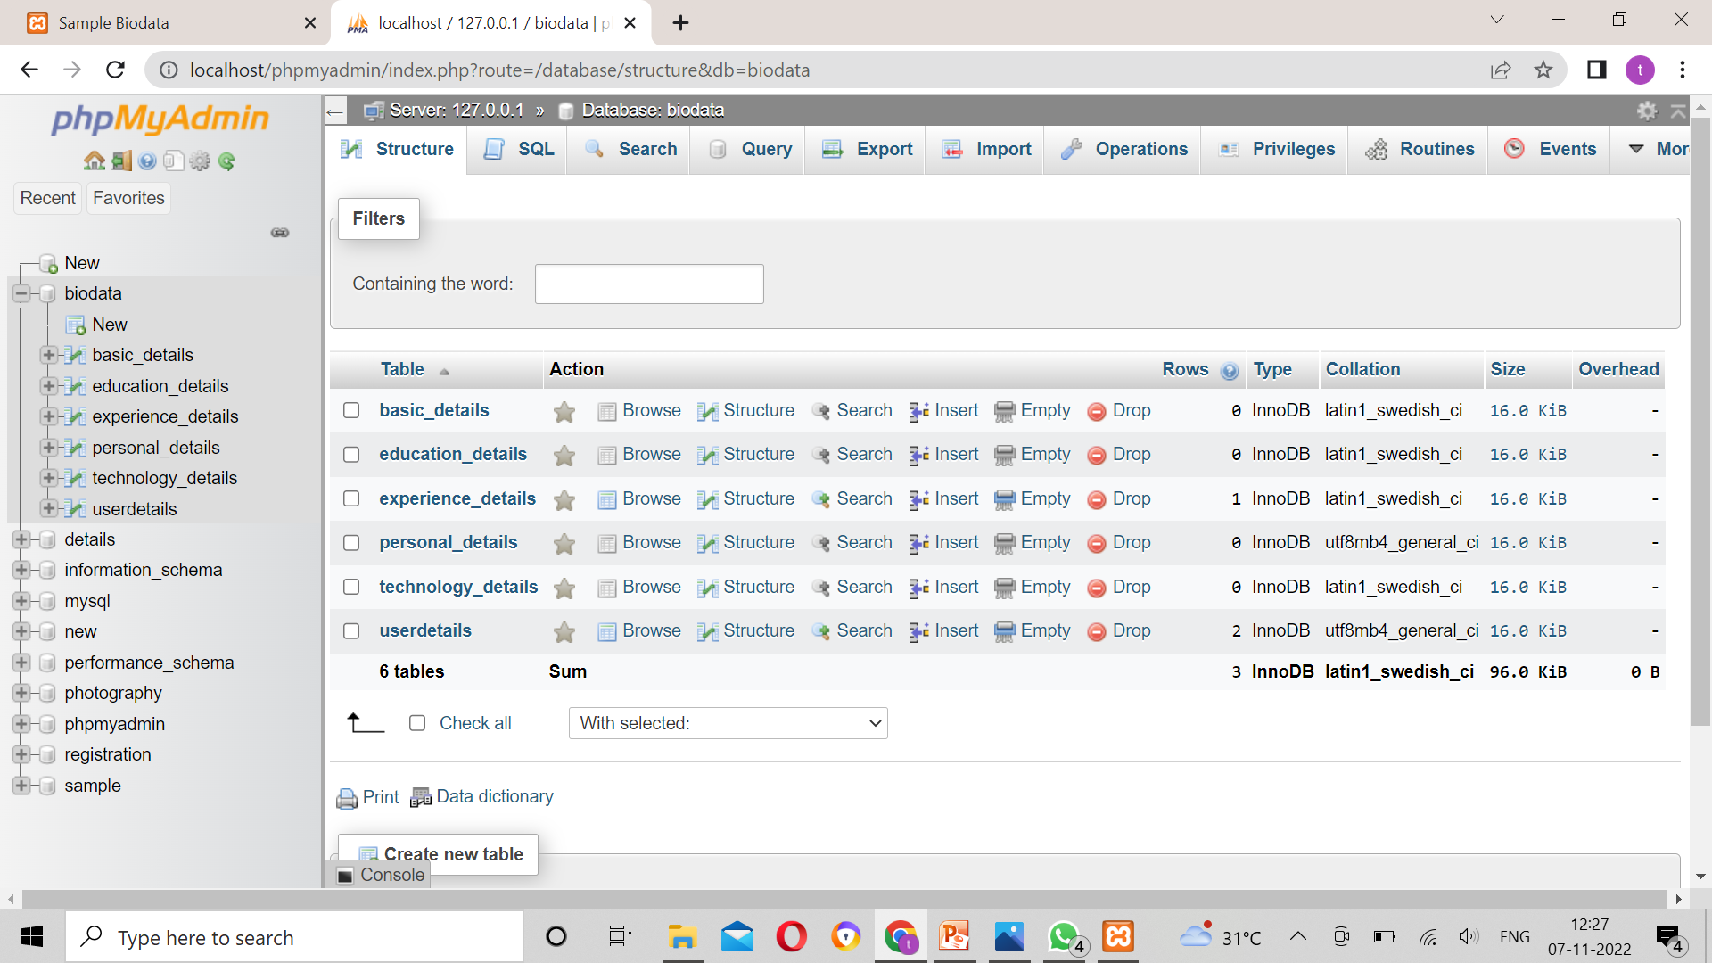
DATABASE

Slide 5
Forms Design
SQL BIODATA DETAILS
USER DETAILS | BASIC DETAILS | EDUCATION DETAILS | PERSONAL DETAILS | TECHNOLOGY DETAILS | EXPERIENCE DETAILS
Notes:
Get the database design from the phpmyadmin or from SRS document

Slide 6
TEAM MEMBER -1

Slide 7
Forms
USER DETAILS
NAME | USER NAME | PASSWORD | EMAIL | MOBILE.NO
Notes:
Explain Form and database worked with

Slide 8
DATABASE DESIGN
SQL
USER DETAILS
BIODATA
NAME
MOBILE
USER DETAILS
USER
EMAIL
PW

Slide 9
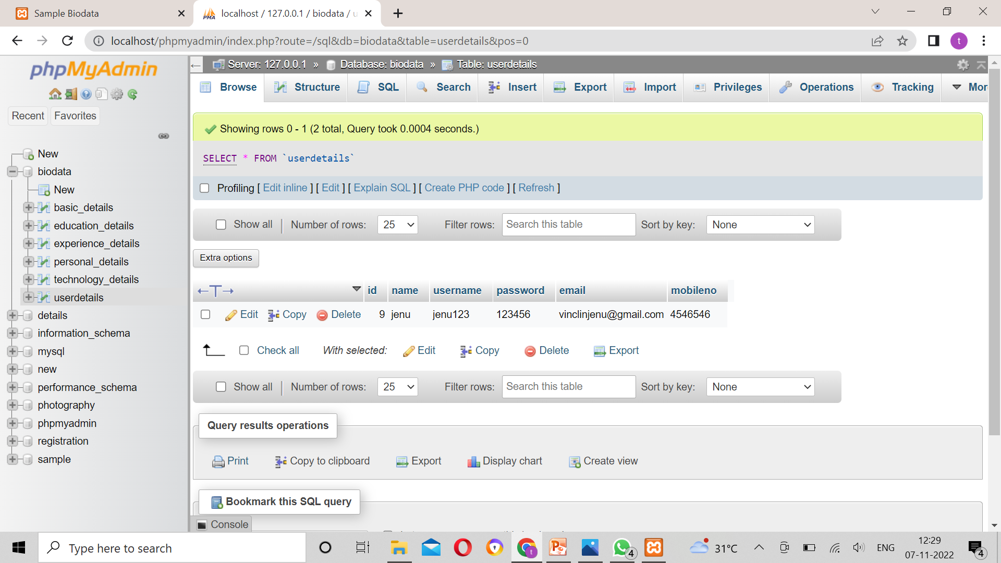
DATABASE

Slide 10
Problem/difficulty Faced
I Faced The Problem On Missing The ID In The Database…..
Notes:
Explain problem faced

Slide 11
Solution to the problem
I Fixed The ID in The Database….Then it solved and get the result…..
Notes:
Explain how attained the solution

Slide 12
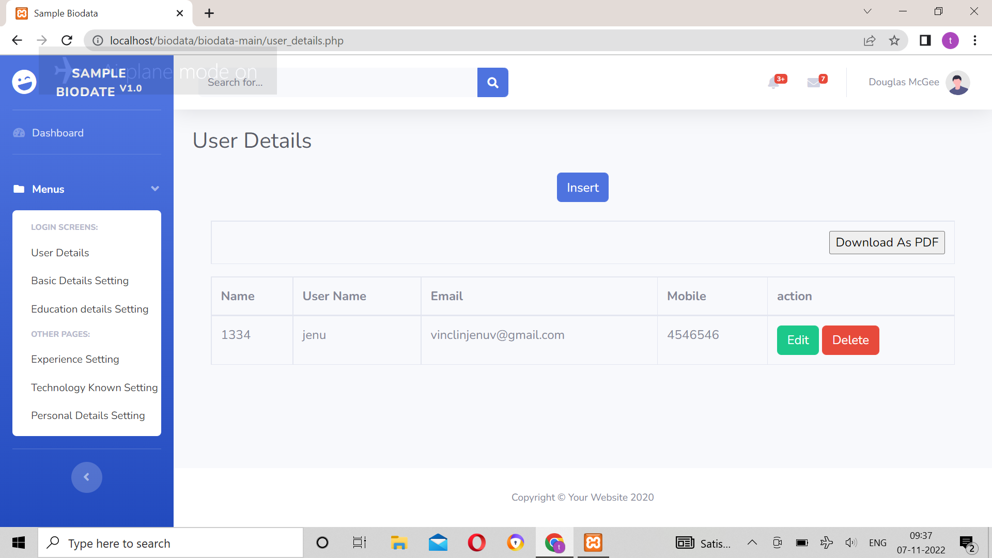
FORMS DESIGN

Slide 13
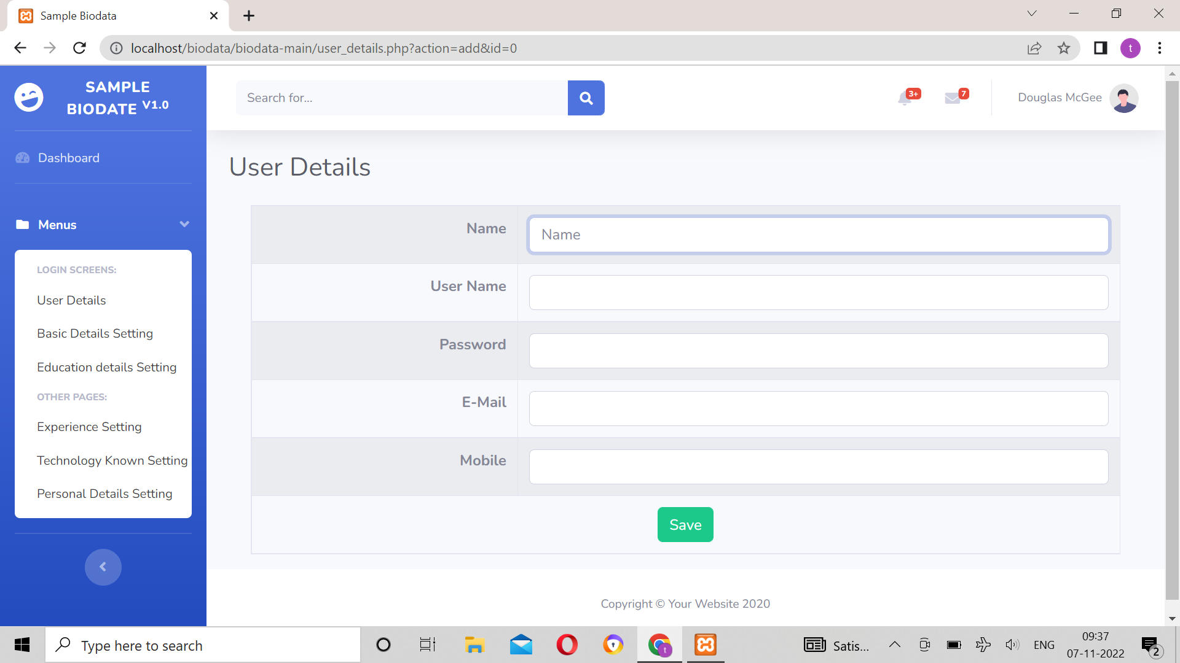
FORM DESIGN

Slide 14
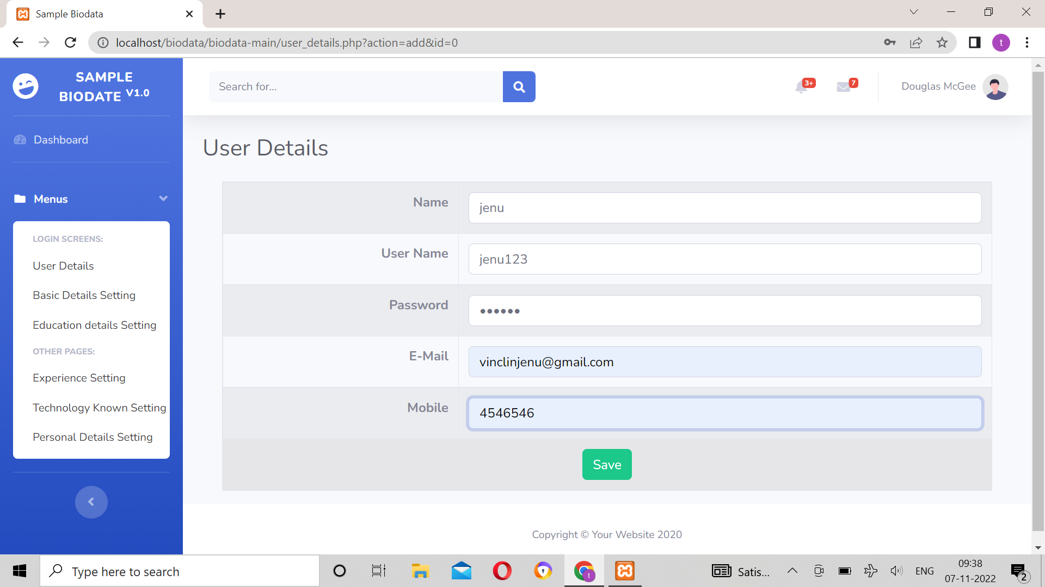
FORM DESIGN

Slide 15
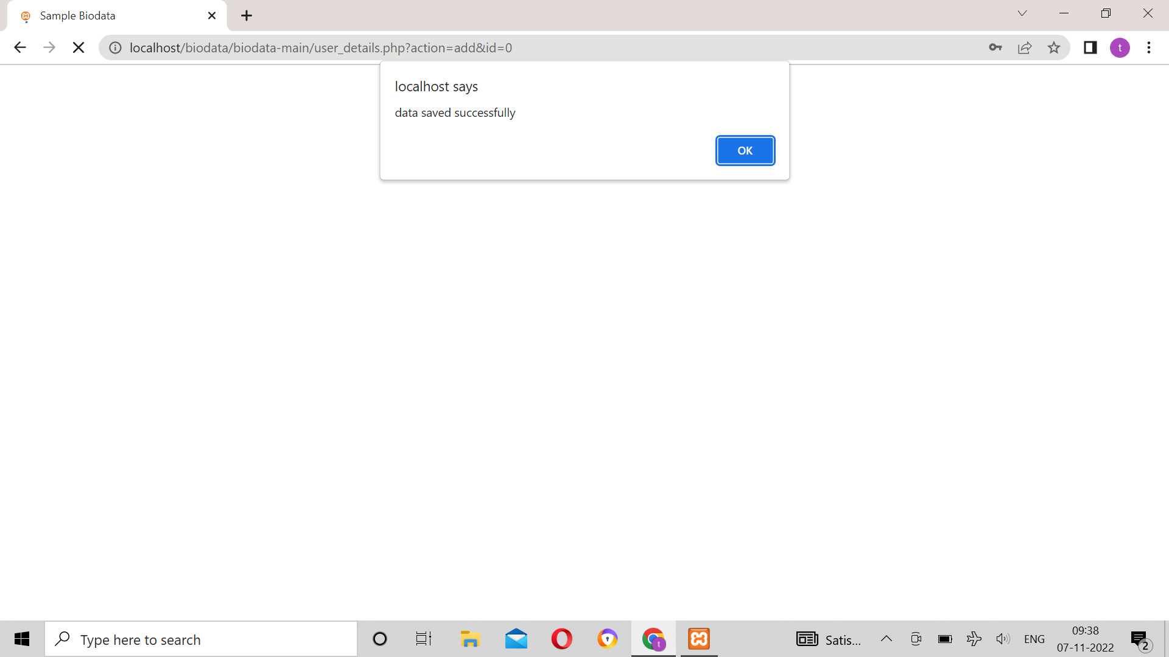
FORM DESIGN

Slide 16
FORMS DESIGN

Slide 17
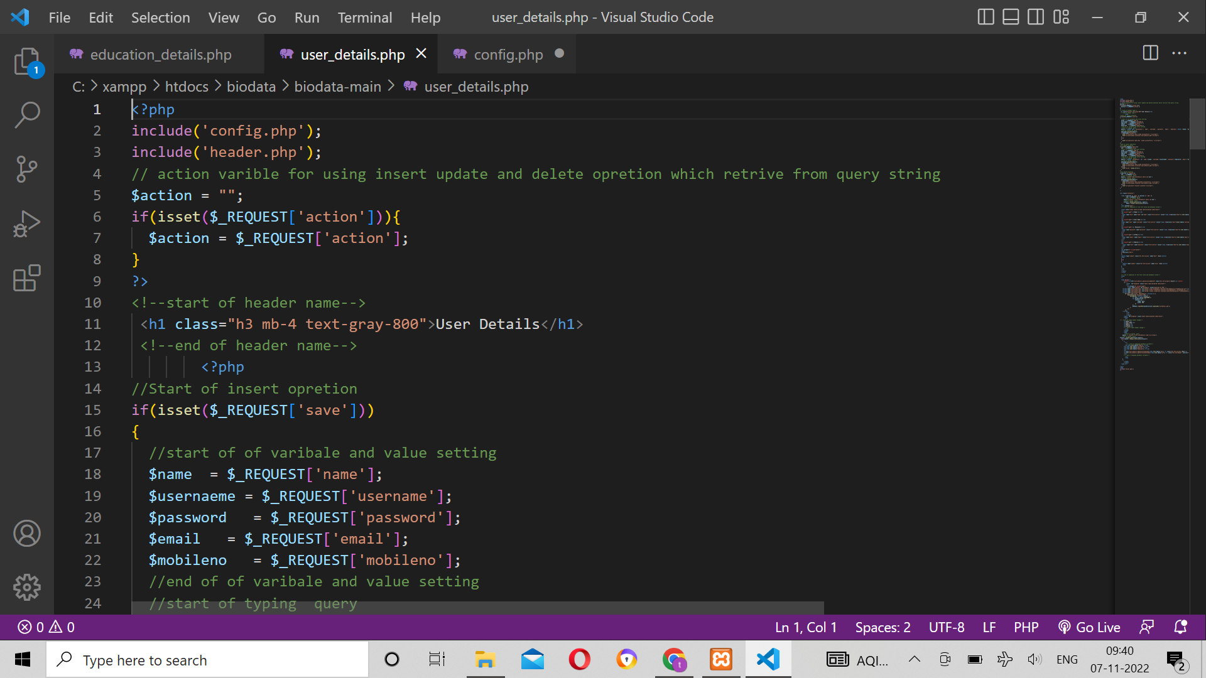
Sample Source code

Slide 18
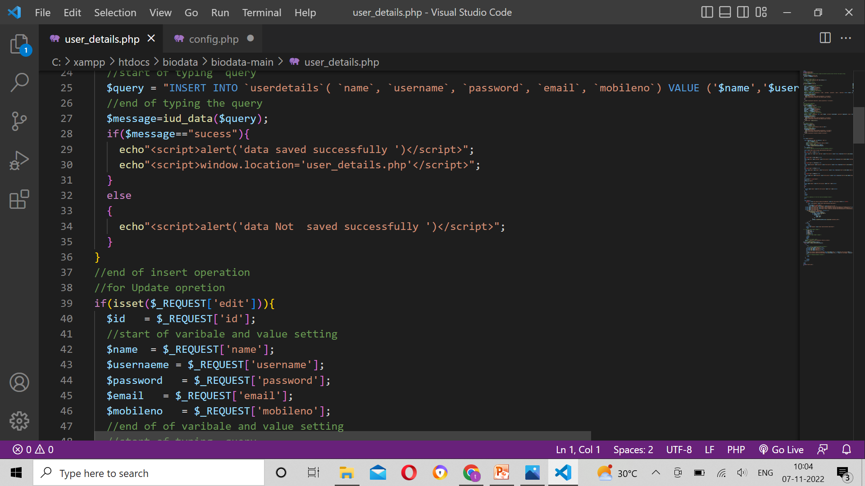
SAMPLE SOURCE CODE

Slide 19
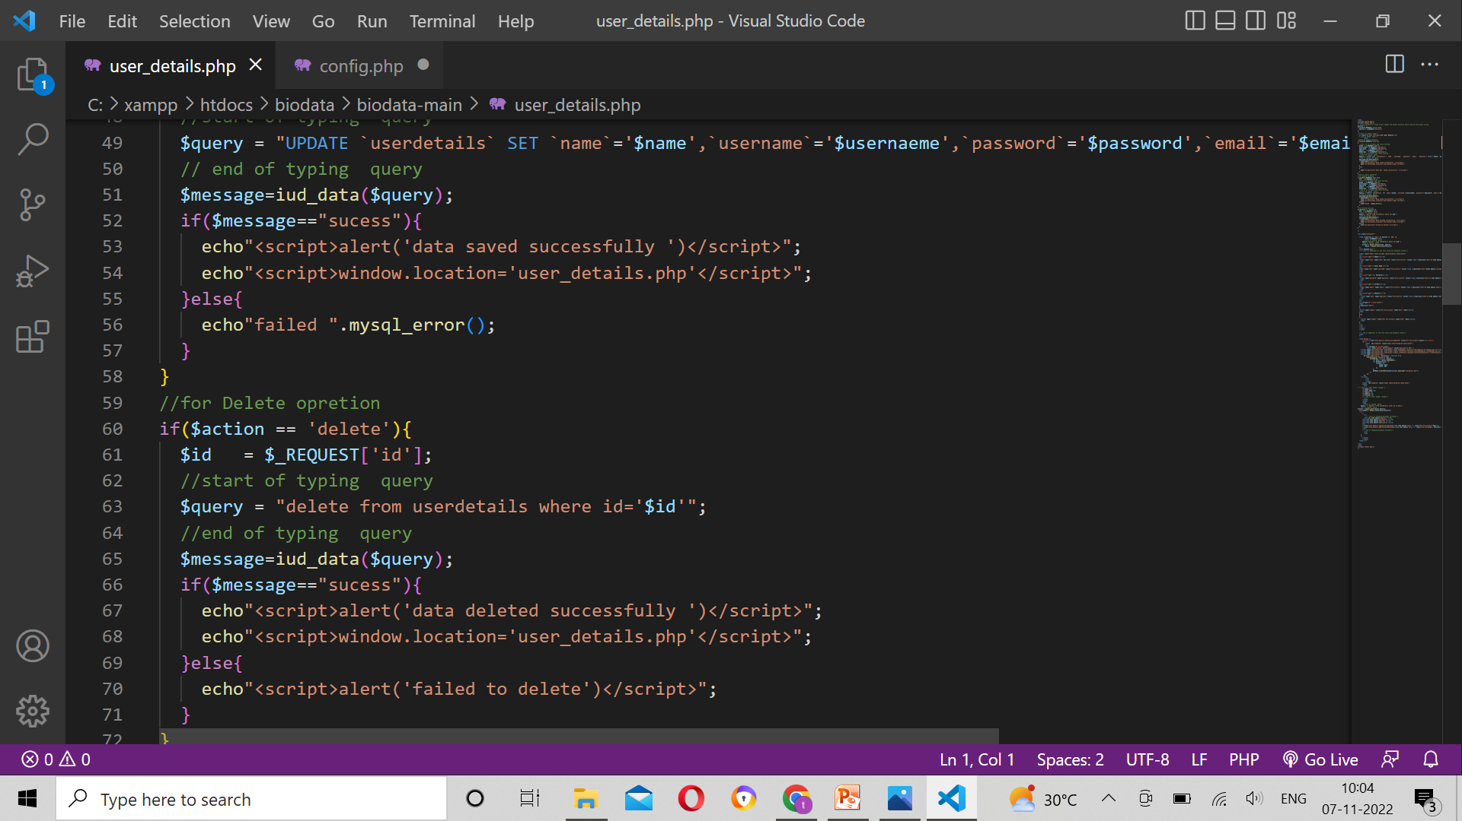
SAMPLE SOURCE CODE

Slide 20
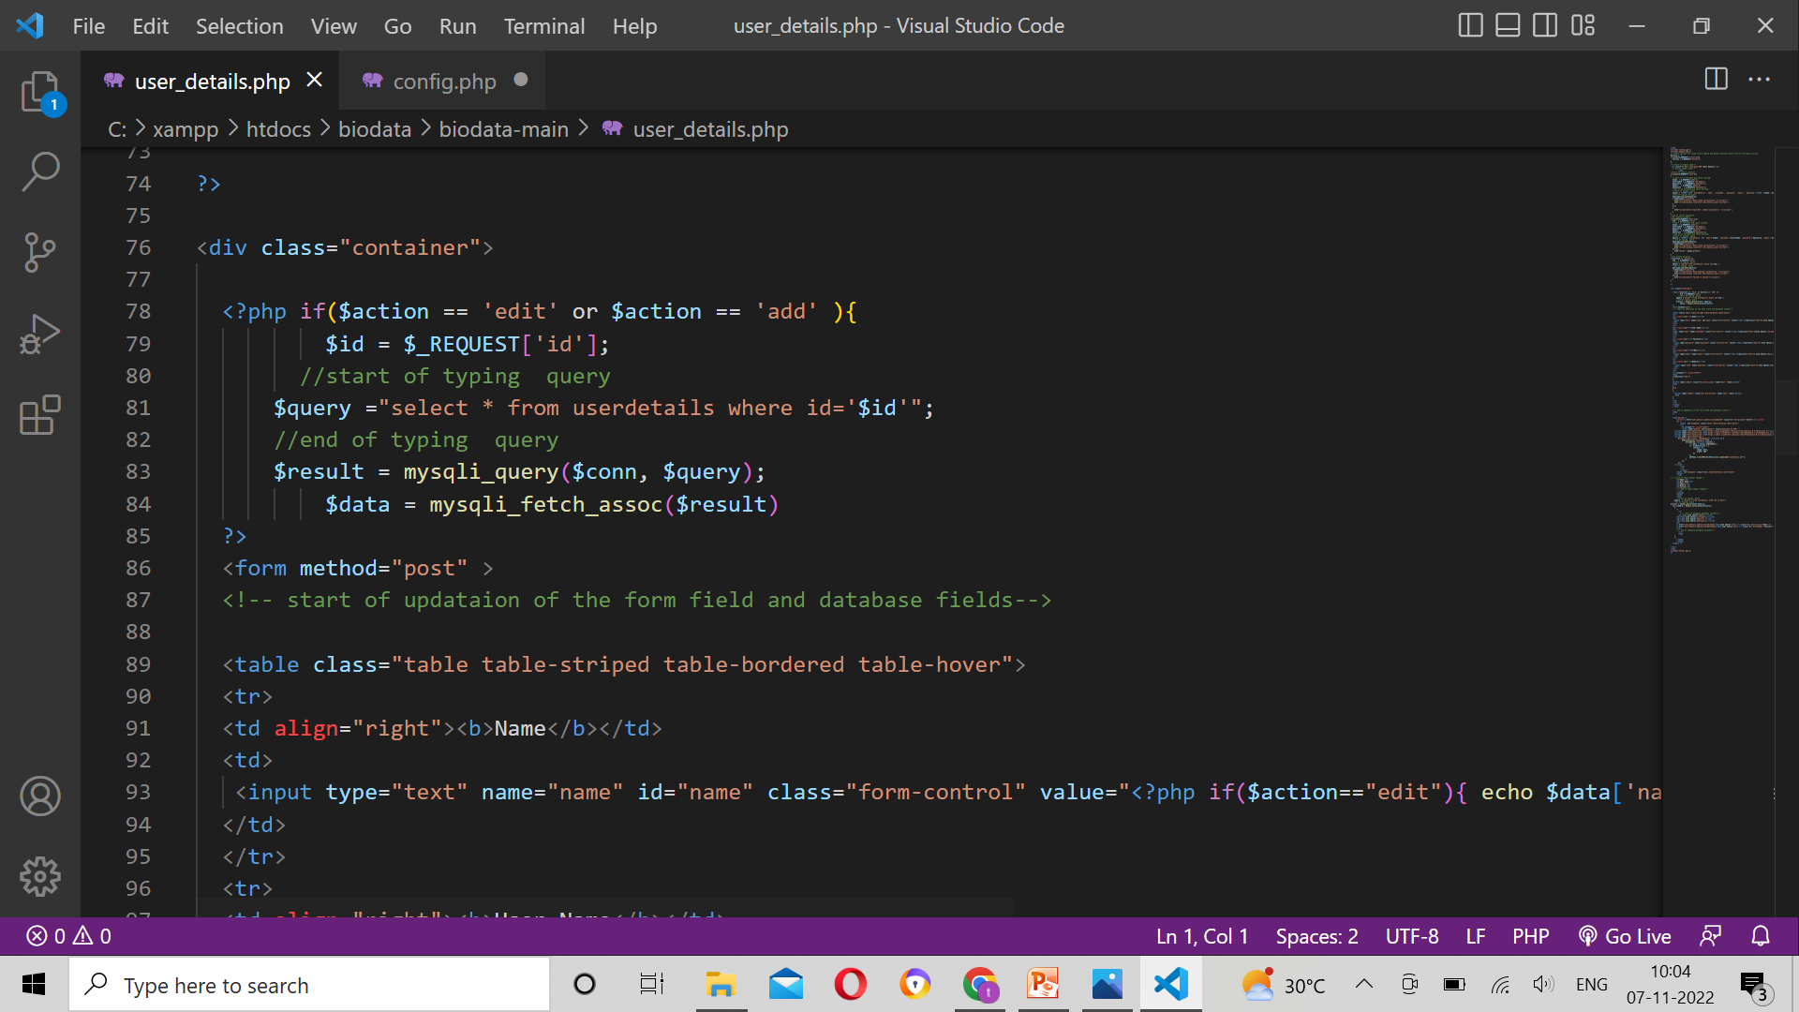
SAMPLE SOURCE CODE

Slide 21
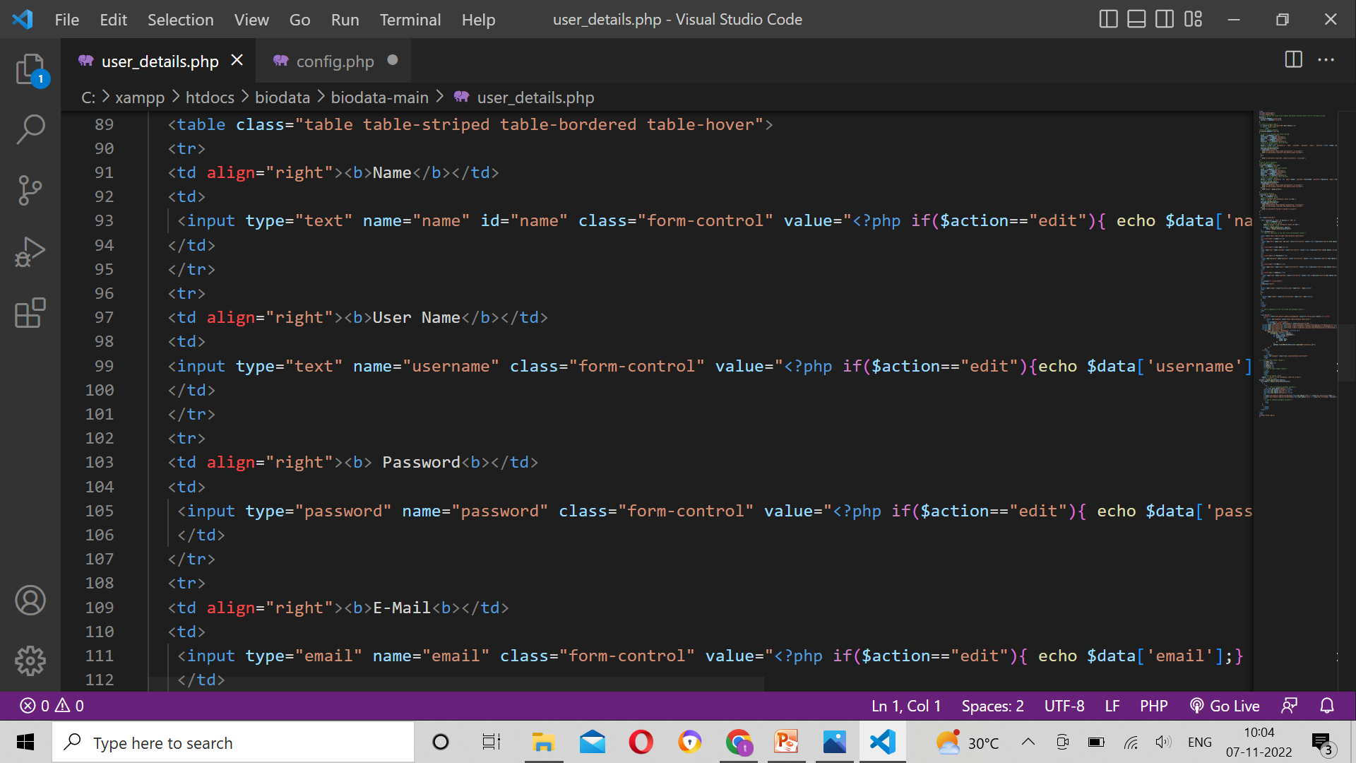
SAMPLE SOURCE CODE

Slide 22
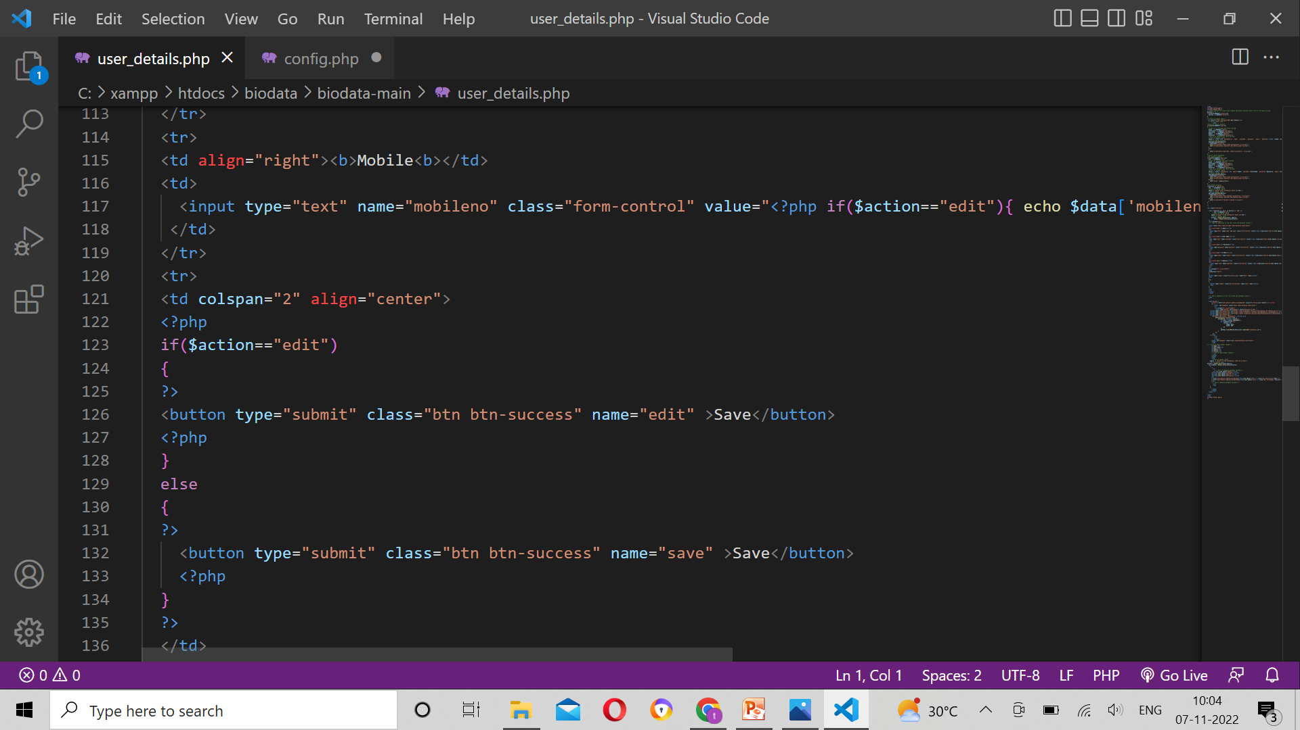
SAMPLE SOURCE CODE

Slide 23
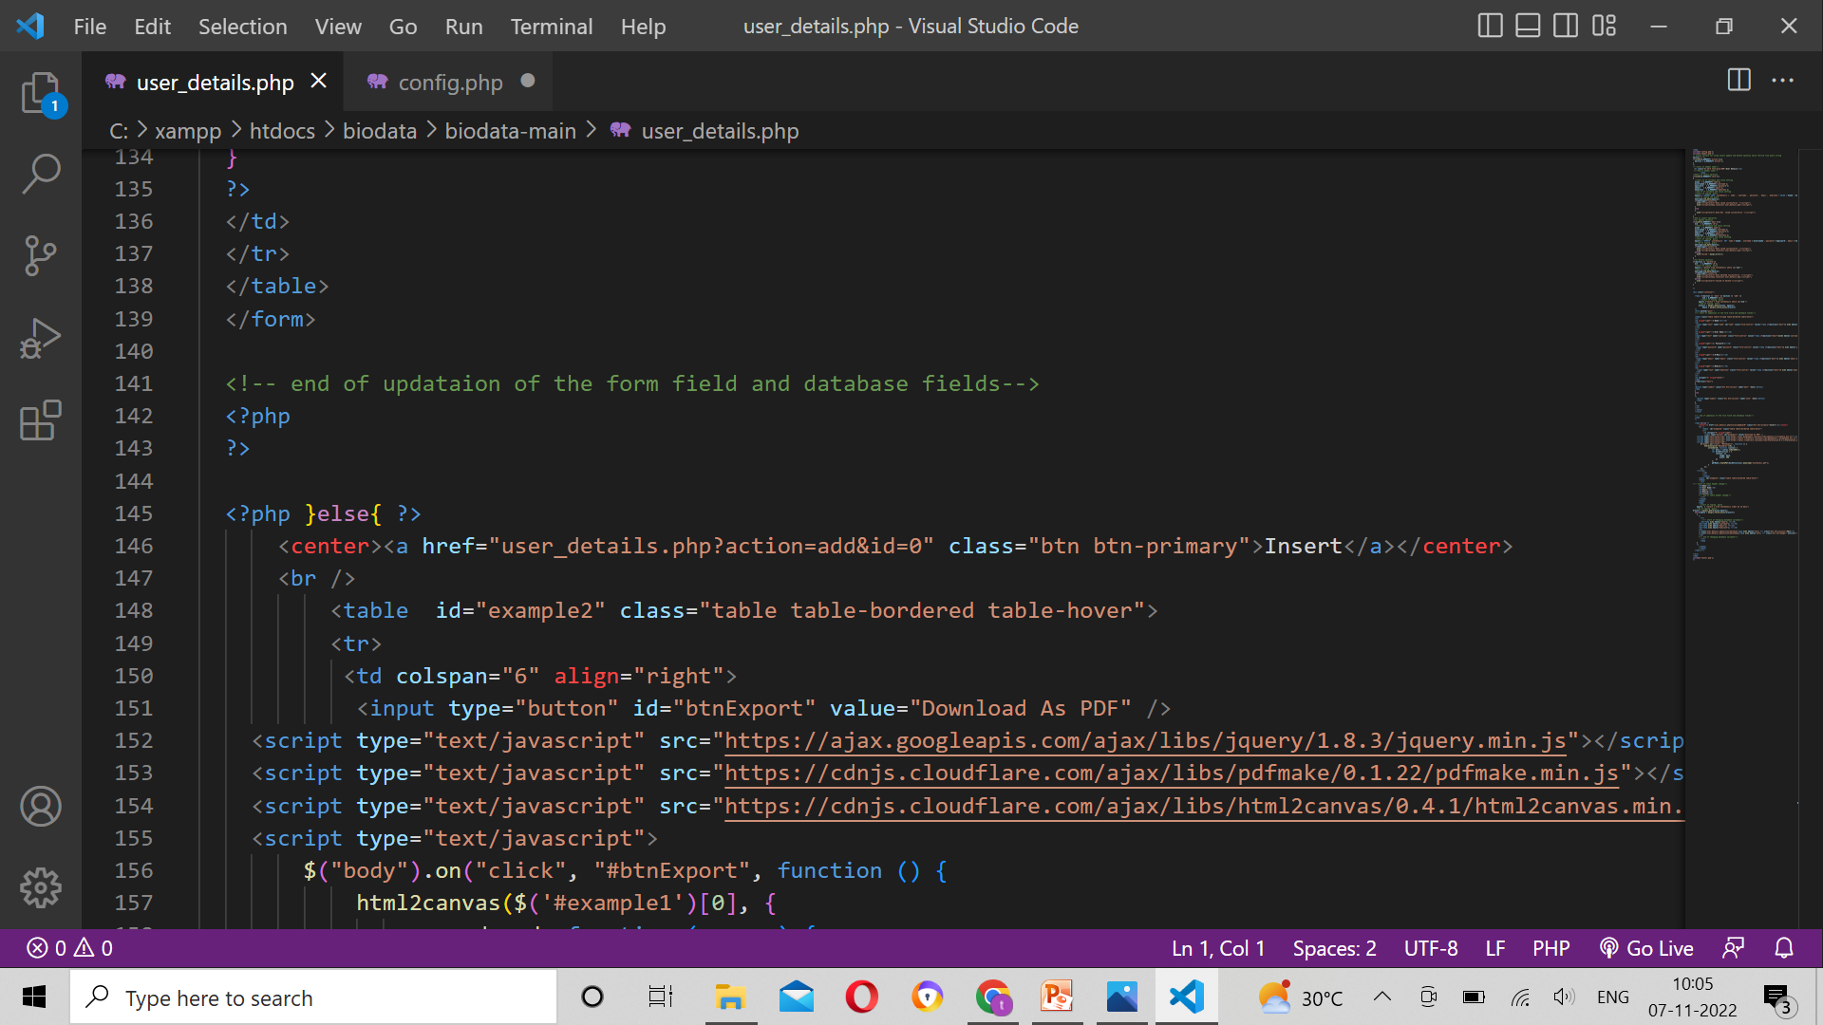
SAMPLE SOURCE CODE

Slide 24
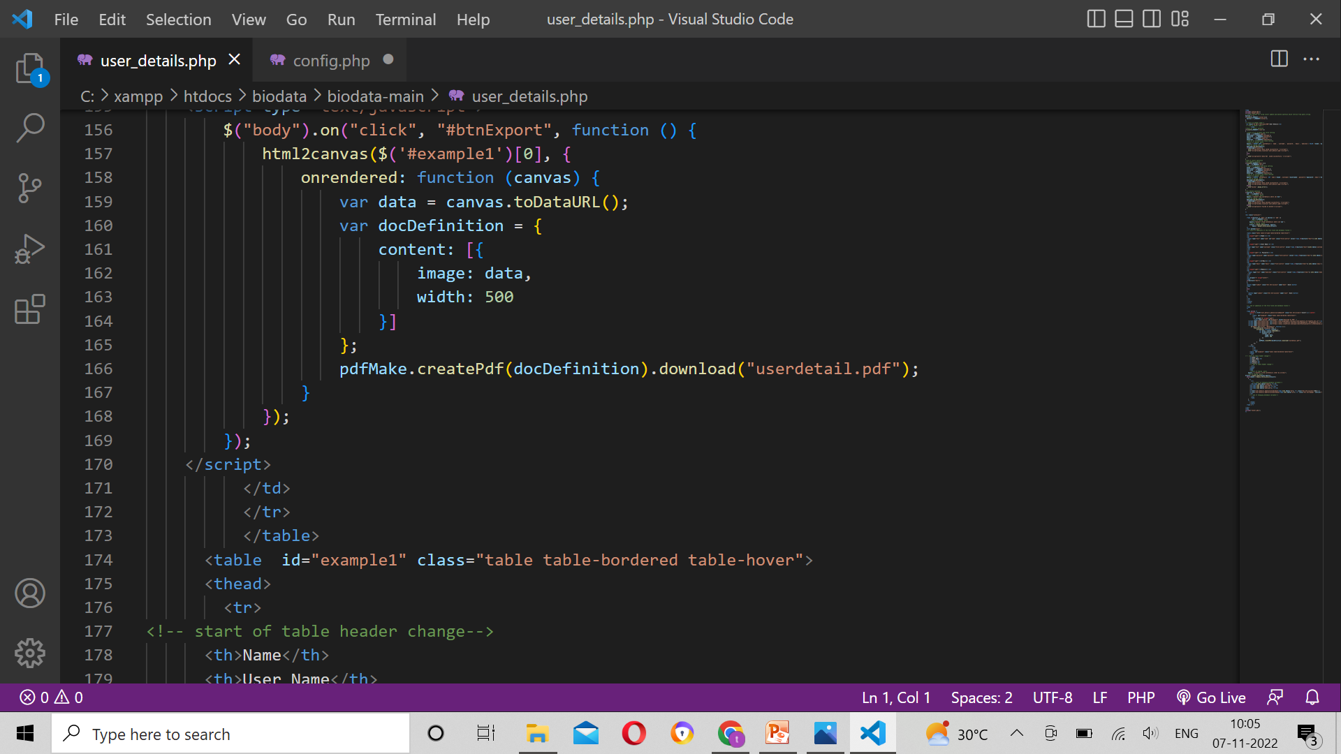
SAMPLE SOURCE CODE

Slide 25
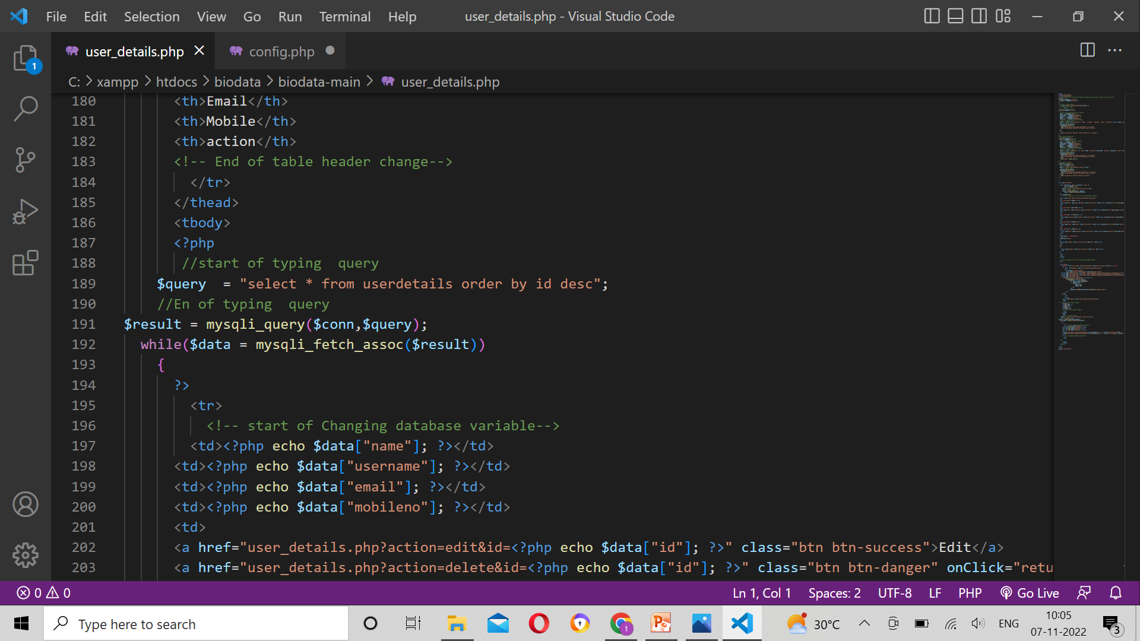
SAMPLE SOURCE CODE

Slide 26
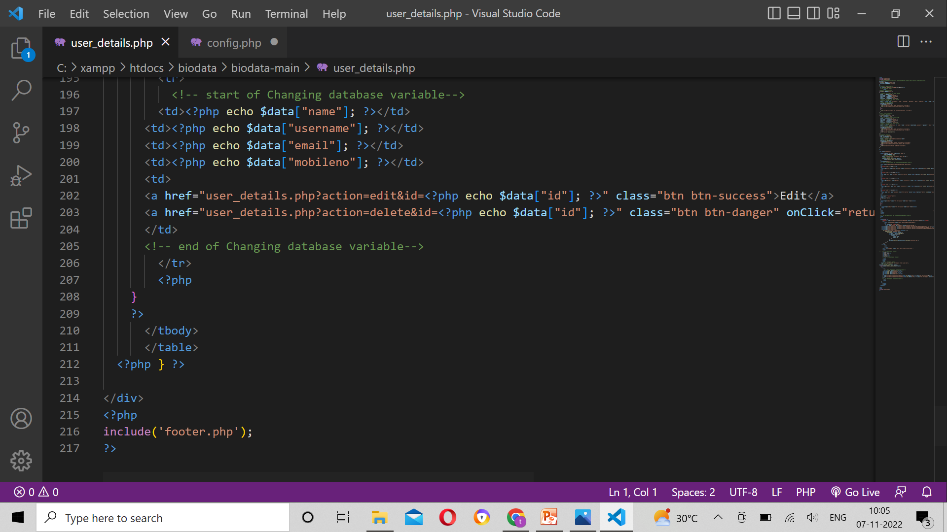
Sample source code

Slide 27
FORMS DESIGN

Slide 28
Thank You

Slide 29
TEAM MEMBER -2

Slide 30
Forms & Database Design
SQL
ROLE
ID
EXPERIENCE DETSILS
USER CODE
EXPERIENCE
ORGANASATION NAME

Slide 31
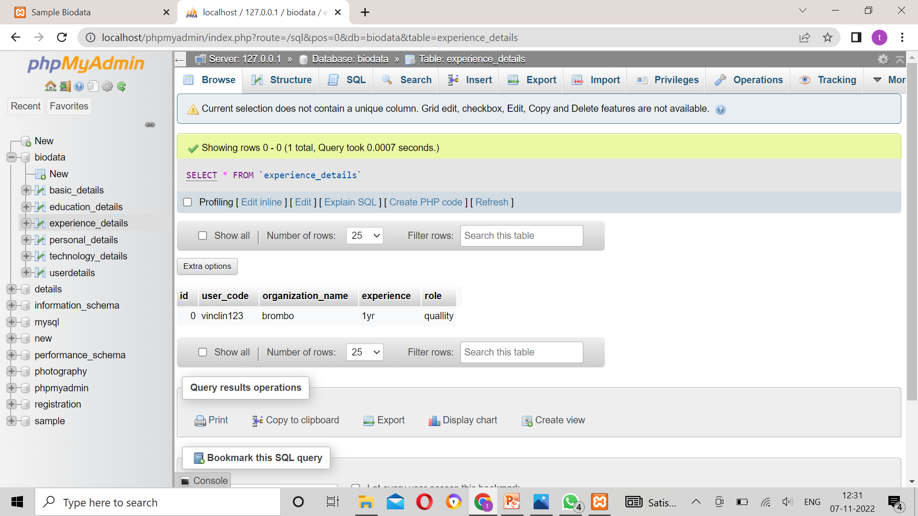
DATABASE

Slide 32
Problem/difficulty Faced
I face the problem on without setting the primary key….

Slide 33
Solution to the problem
In The Data base….I change the ID as Primary key…then the problem was fixed…..

Slide 34
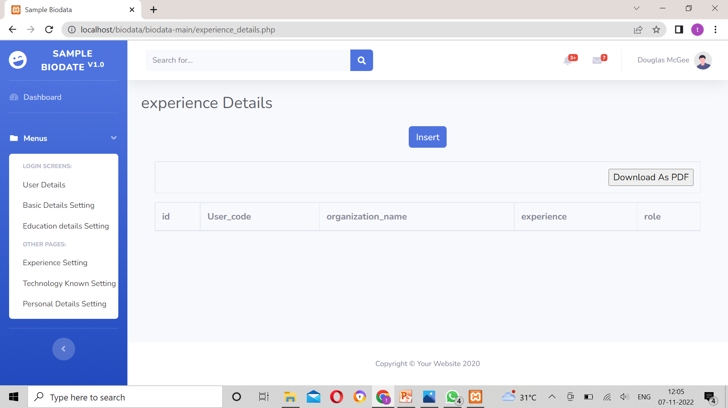
FORMS DESIGN

Slide 35
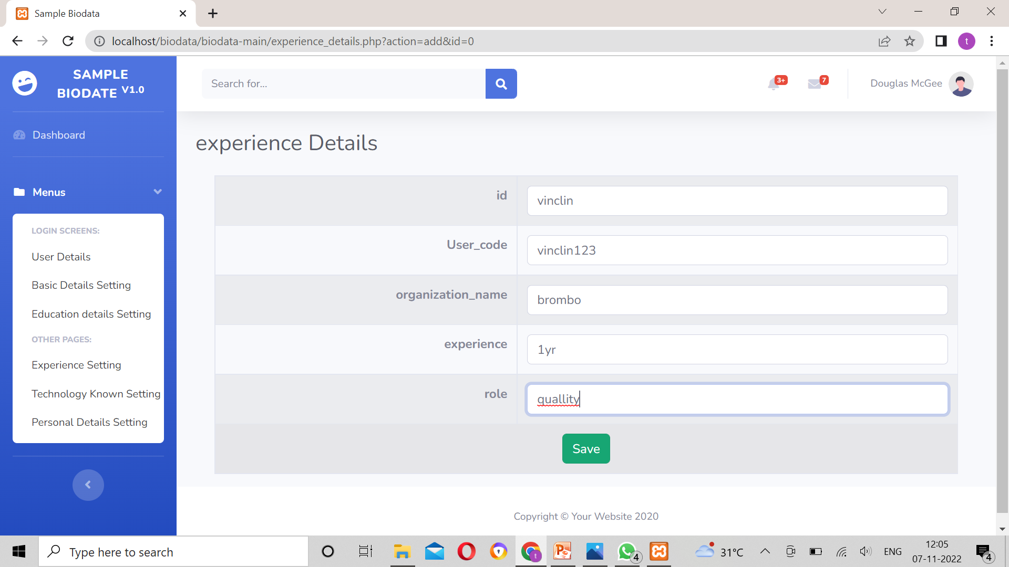
FORMS DESIGN

Slide 36
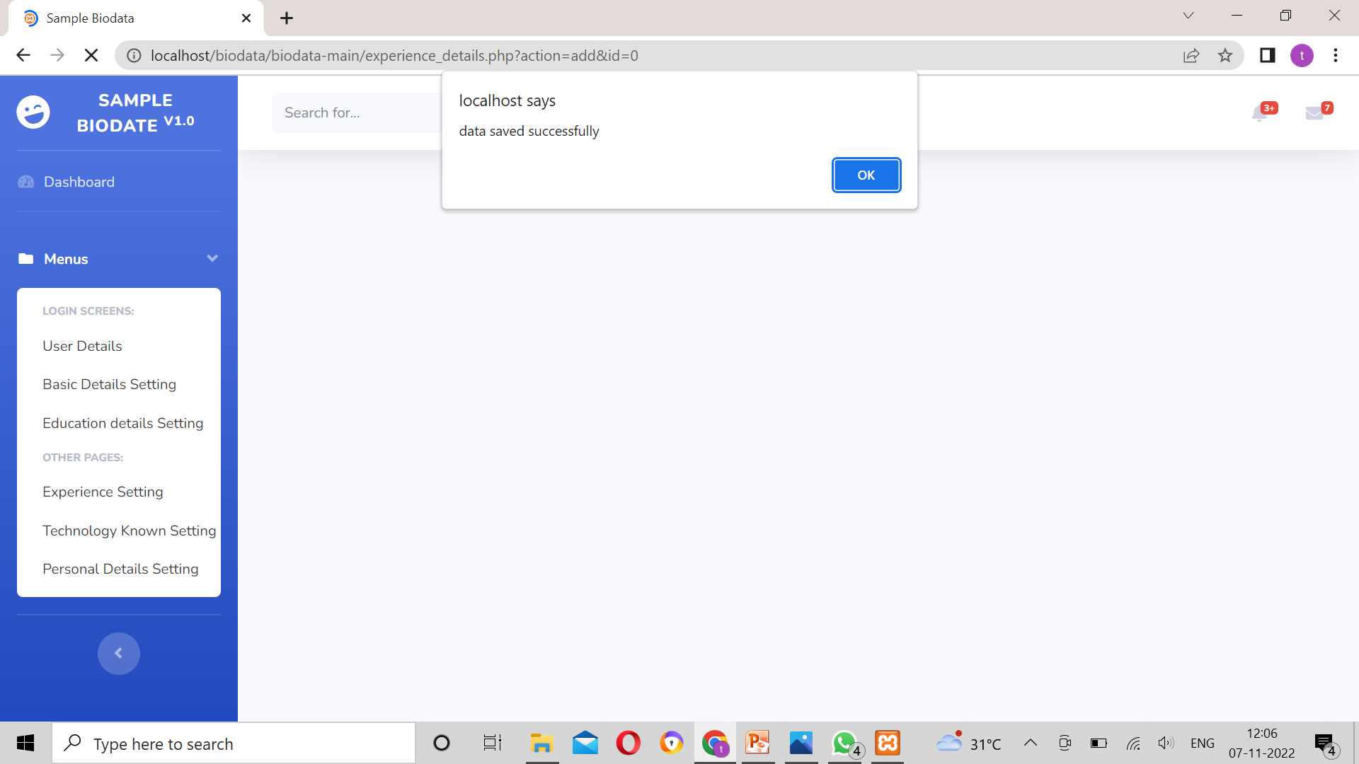
FORMS DESIGN

Slide 37
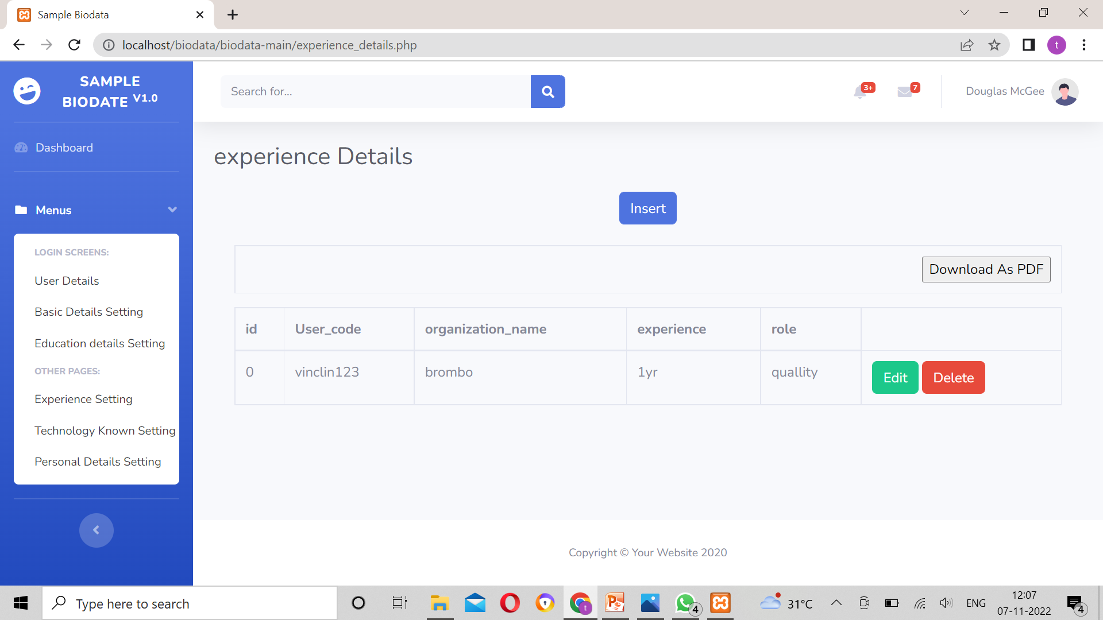
FORM DESIGN

Slide 38
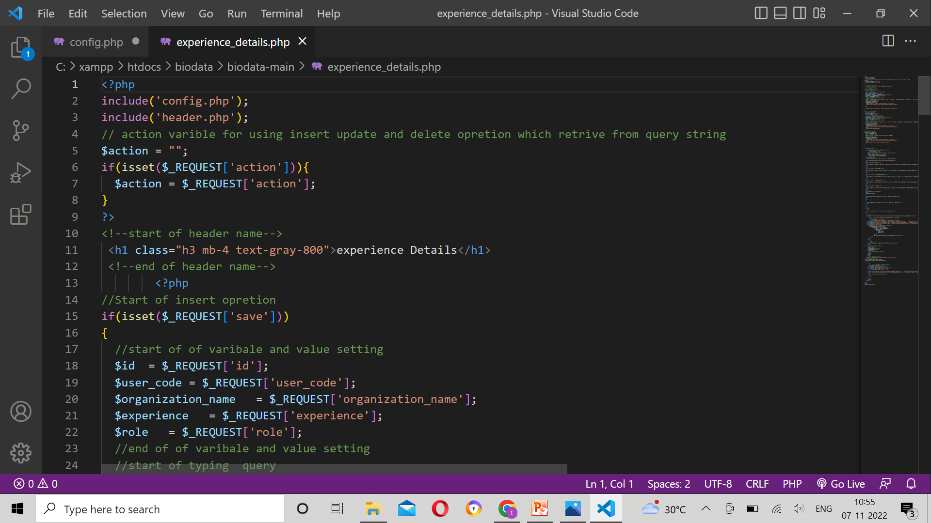
Sample Source code
Notes:
Explain how attained the solution

Slide 39
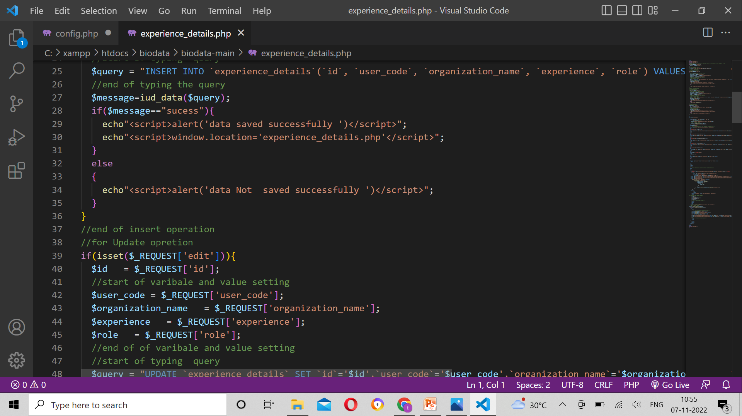
SAMPLE SOURCE CODE

Slide 40
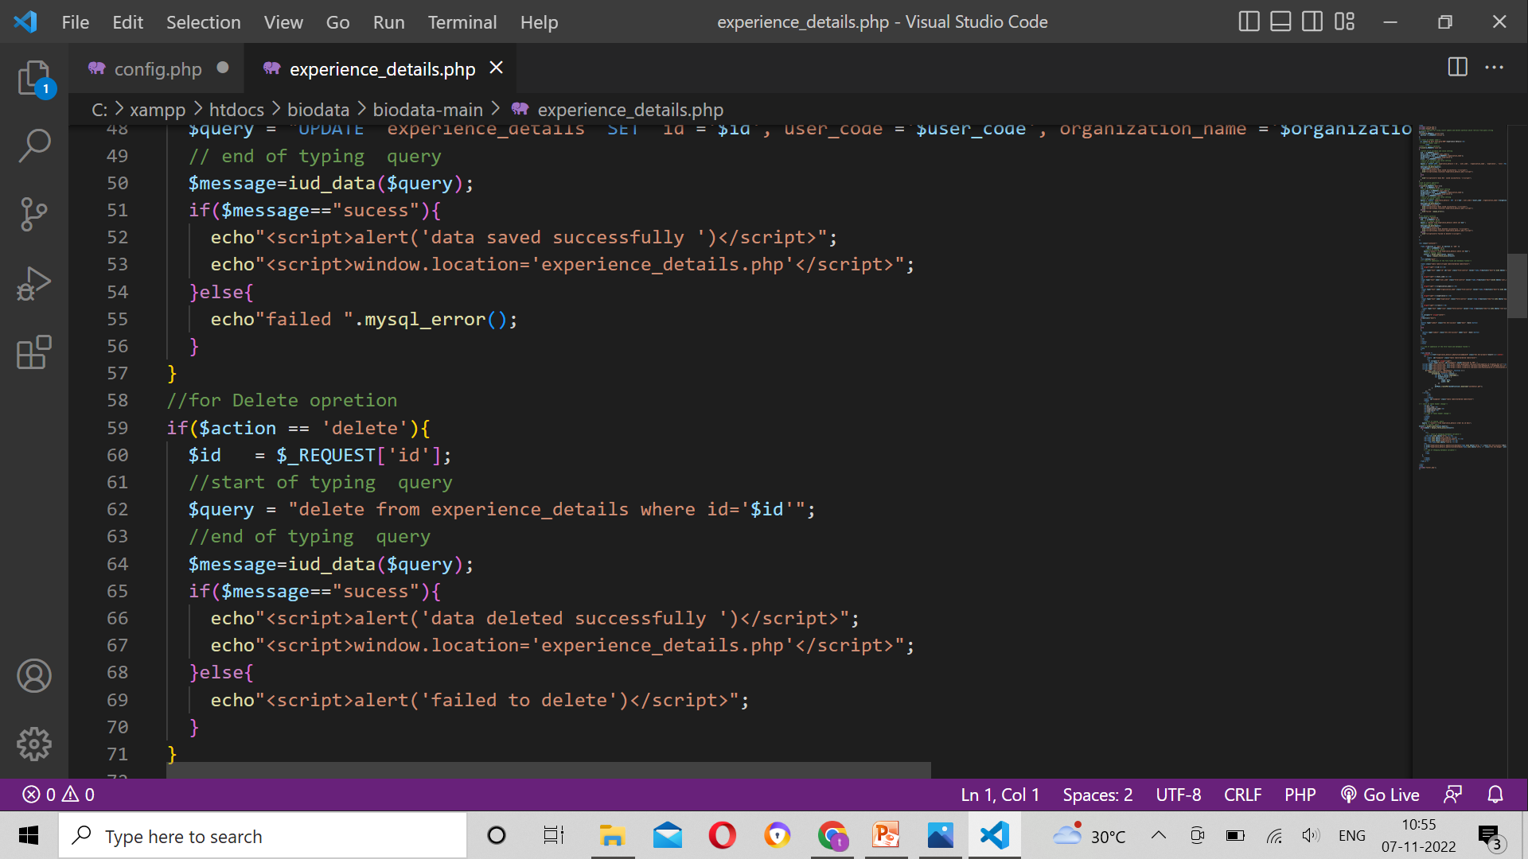
SAMPLE SOURCE CODE

Slide 41
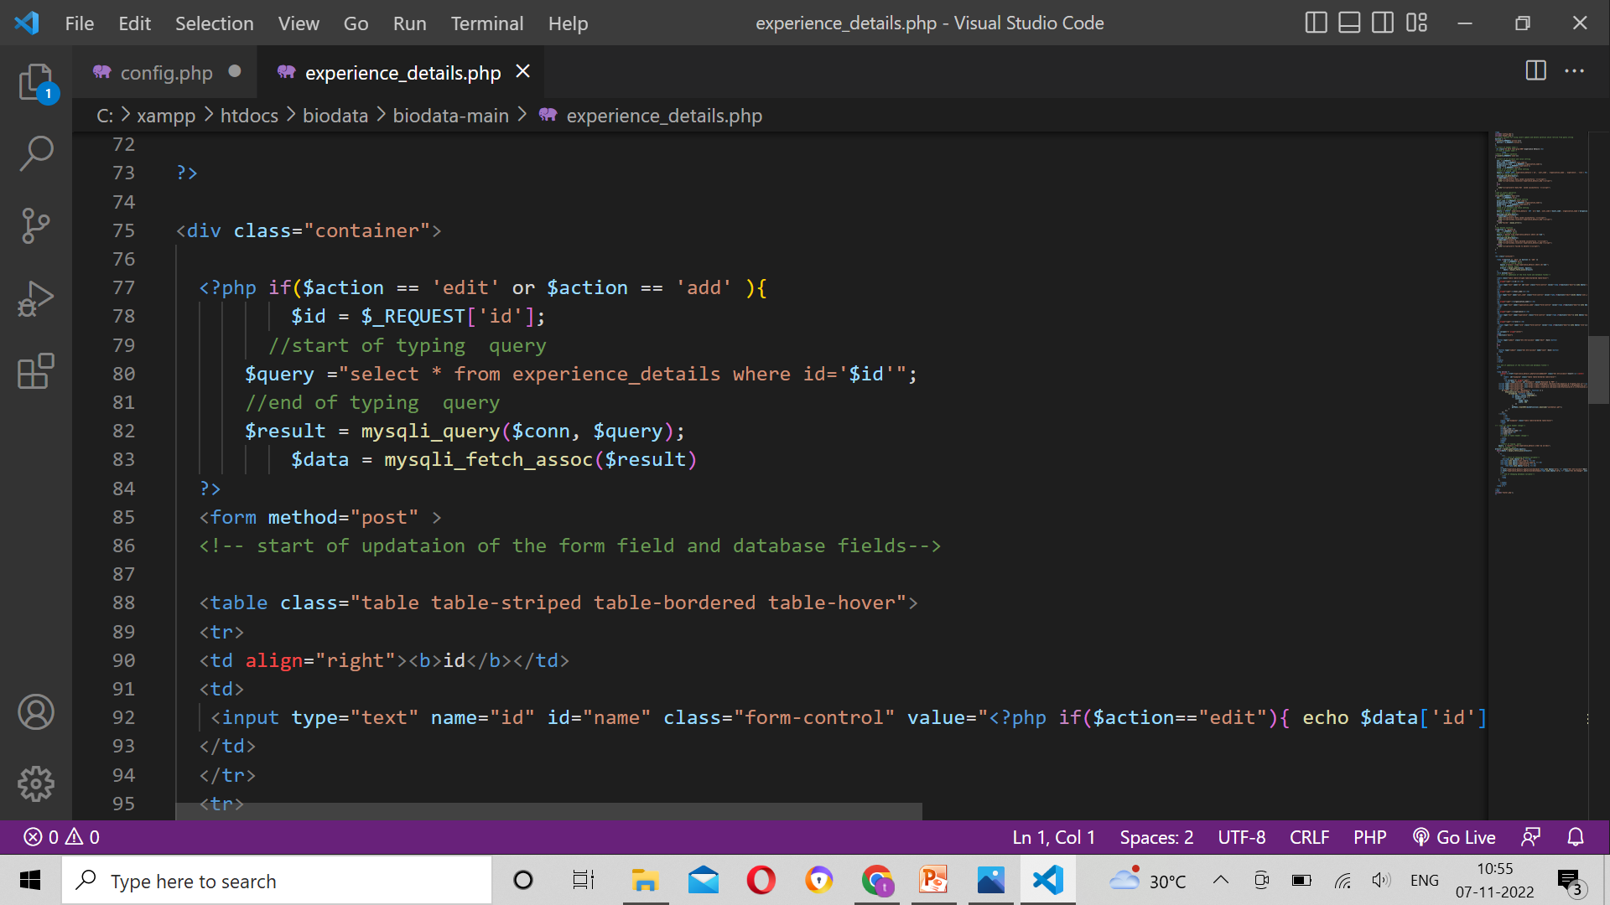
SAMPLE SOURCE CODE

Slide 42
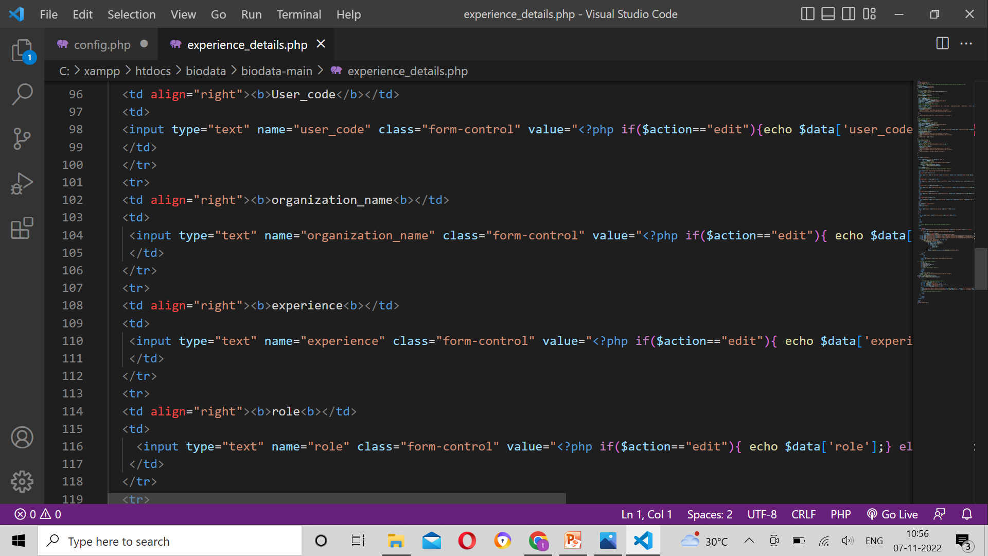
SAMPLE SOURCE CODE

Slide 43
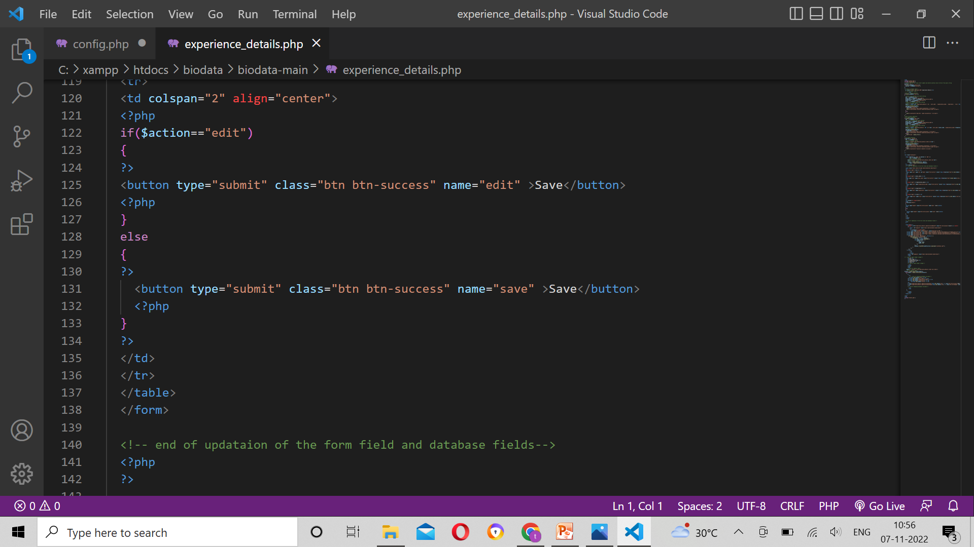
SAMPLE SOURCE CODE

Slide 44
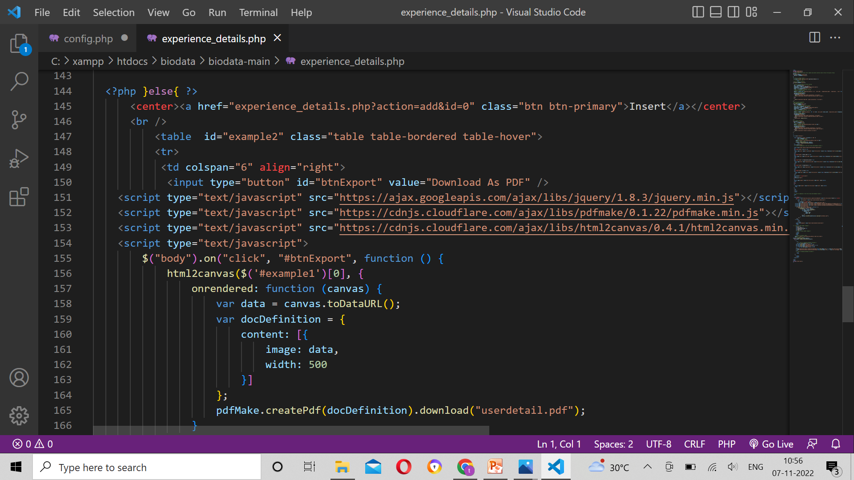
SAPLE SOURCE CODE

Slide 45
SAMPLE SOURCE CODE

Slide 46
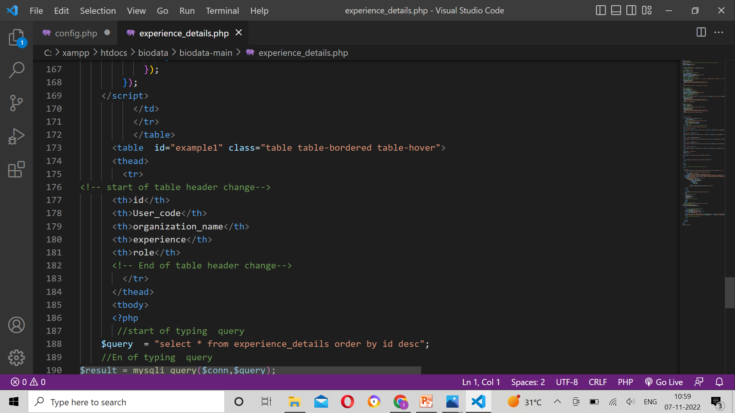
SAMPLE SOURCE CODE

Slide 47
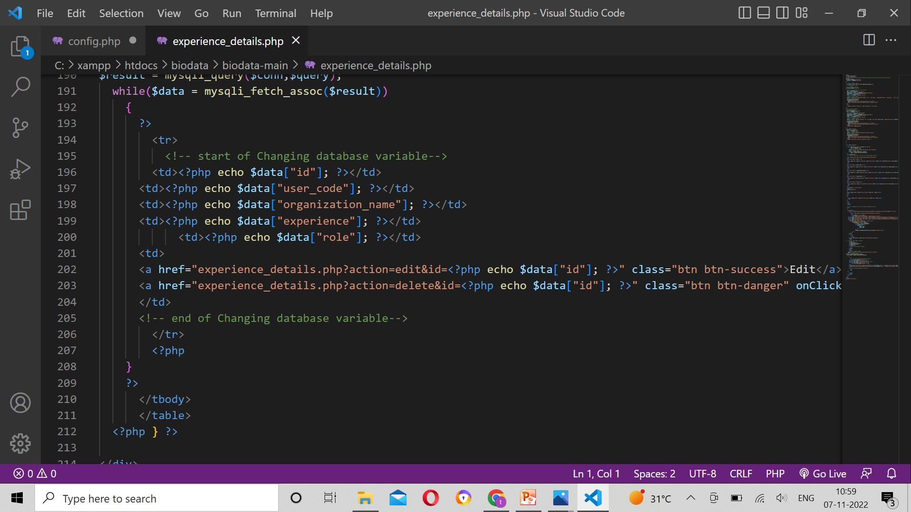
SAMPLE SOURCE CODE

Slide 48
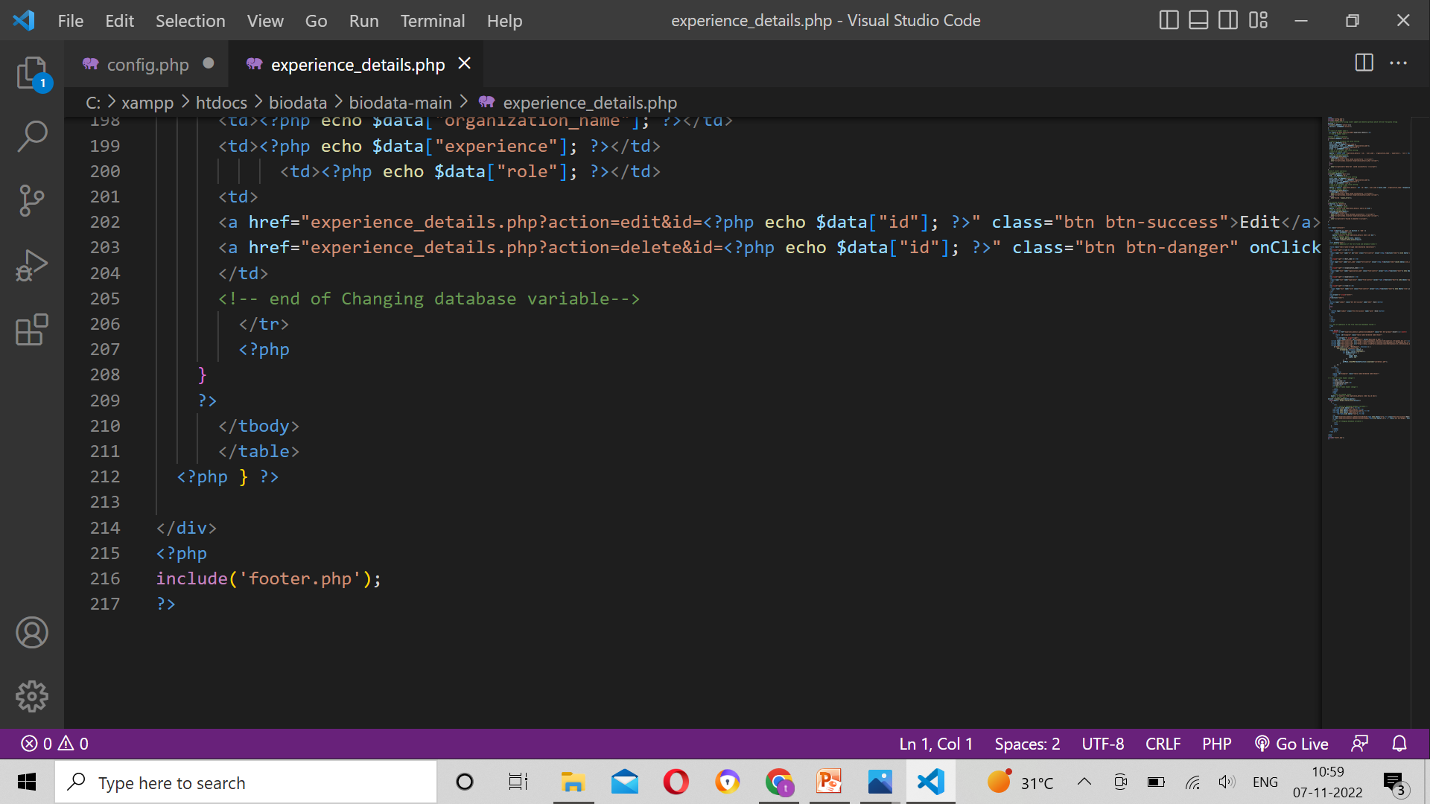
SAPLE SOURCE CODE

Slide 49
FORM DESIGN

Slide 50
Thank You

